Slide 1


Slide 2





Njambi…
Is a Wife
To a doctor
Works
At her own boutique
Has a Family
With 3 healthy children
Cooks
On a daily basis like most African households

Slide 3








The Problem
Inconvenience
Uncertainty
Price Gouging
Njambi has to shop at different places for groceries, wasting a lot of time and energy
Njambi is sometimes unsure of the quality of the products bought
Continuous exploitation of customers compounded by the rapid rise of living standards has led to exorbitant prices

Slide 4



Our Solution…
Convenience
Quality Assurance
Fair pricing
Order online, Qijani delivers weekly grocery packages to your doorstep
By simplifying the supply chain, products from us arrive fresh at your door
An algorithm that uses supply and demand data will ensure that prices are affordable

Slide 5
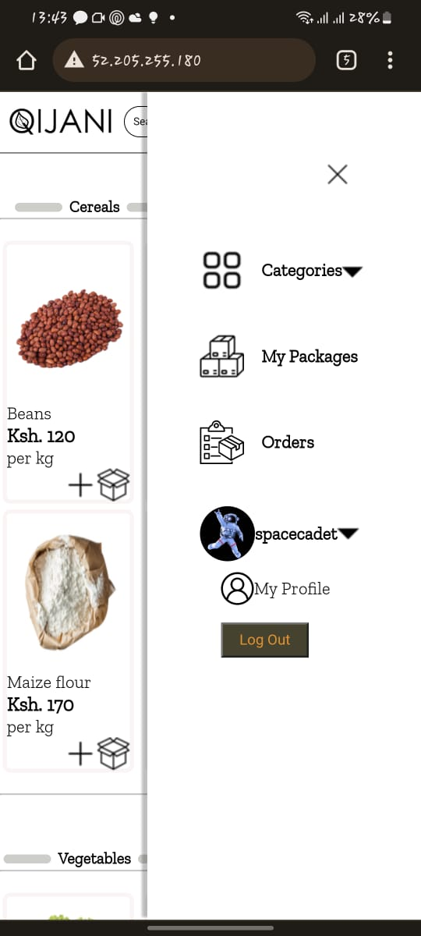
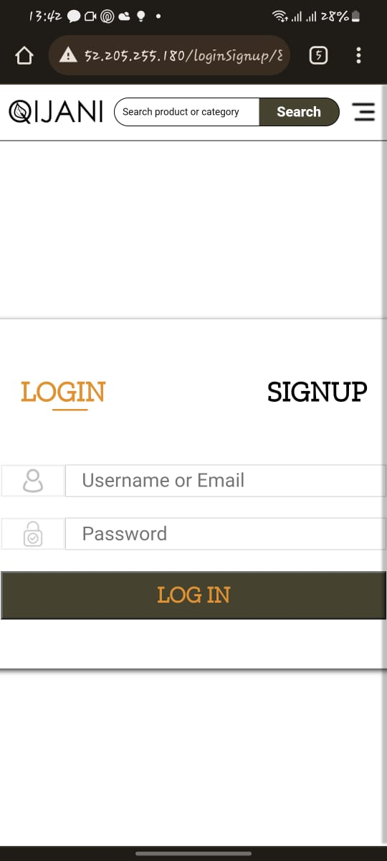
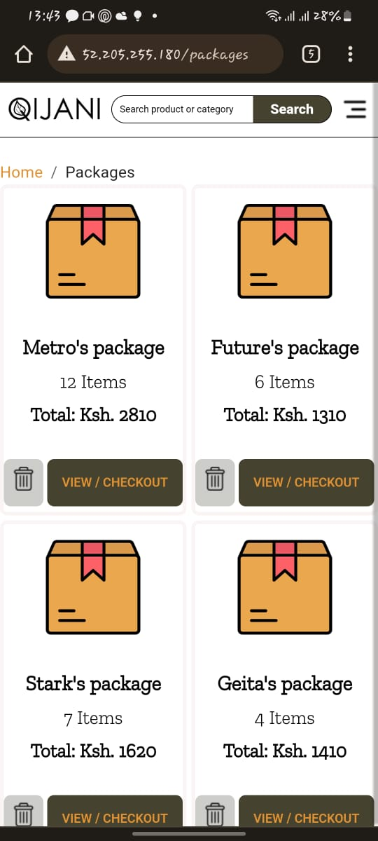
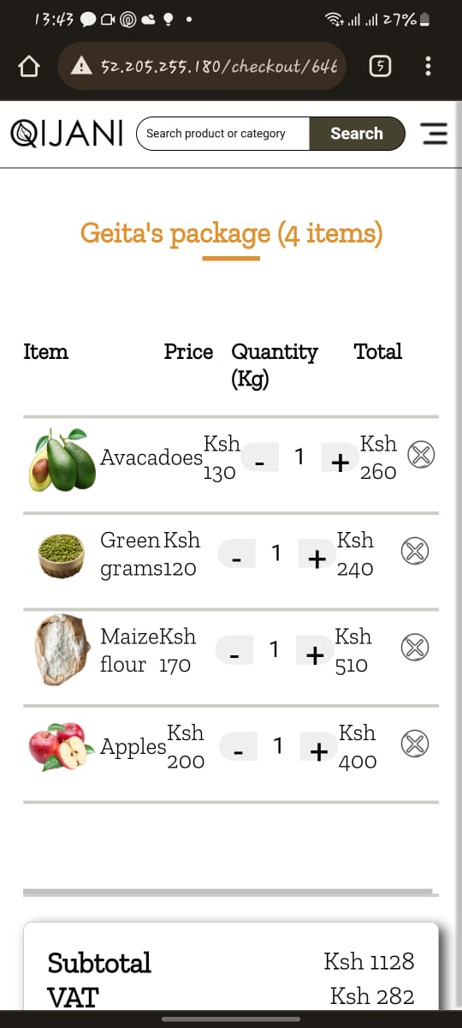
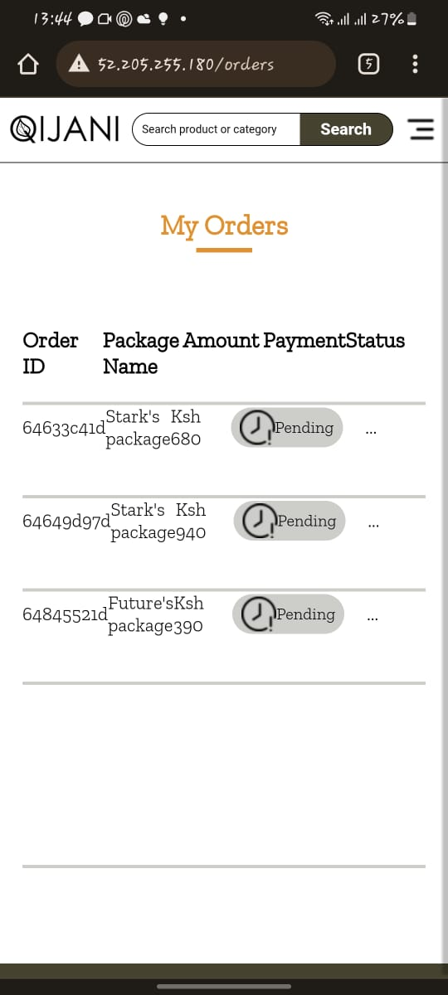
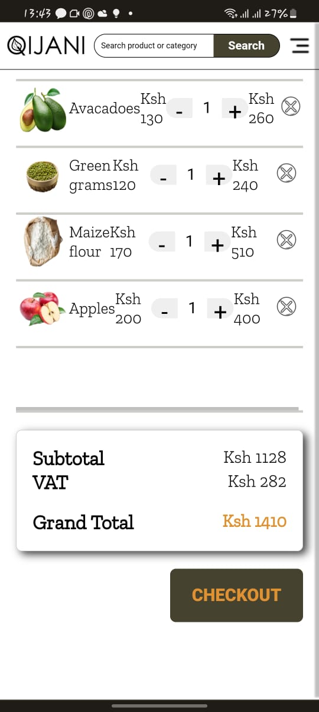
Our Platform

Slide 6






Business Model
State of Affairs
5-6%**
10-12%**
5%**
10%**
Farmer
Broker 1
Broker 2
Wholesaler
Market/Kiosk/Kibanda
Consumer
With Qijani in Place
15%**
Farmer
Consumer
** - Margin based on current market data on potatoes and maize

Slide 7






Market
4 out of 10 people currently use e-commerce platforms in Kenya
$0.46 of every $1 spent on household shopping is spent on food
TAM
SAM
SOM
$ 55 on average spent on grocery shopping a week (In a house of 4)
$ 56B
$ 8B
$ 800M*
* - Calculation based on serving10% of households in Nairobi, Mombasa, Nakuru and Kisumu cities

Slide 8


Competitors
Open air markets

Slide 9




Why Us
Bulk Purchase
Delivery
Our grocery package plans last for at least a week
We offer doorstep delivery
Price
Health
Affordable pricing
Auto-recommendation of food package plans based on your current health status

Slide 10





Go to Market Plan
Target Market
01
02
Strategy
All African households
Affiliate marketing
Small deliveries
Content creation
Channel Partner Marketing
03
04
Launch Team
Build energetic team
Get to work
Private Chefs
Event planners
Recipes

Slide 11







Roadmap
Order fulfillment
Customer acquisition
Release of web app v1.0
July 2023
June 2023
Customer validation
June 2023
Prototype development
Web app
Research
May 2023
Market research
Surveys
Product research
Feb 2023
Idea generation and mobilization
Jan 2023
Jan 2023

Slide 12
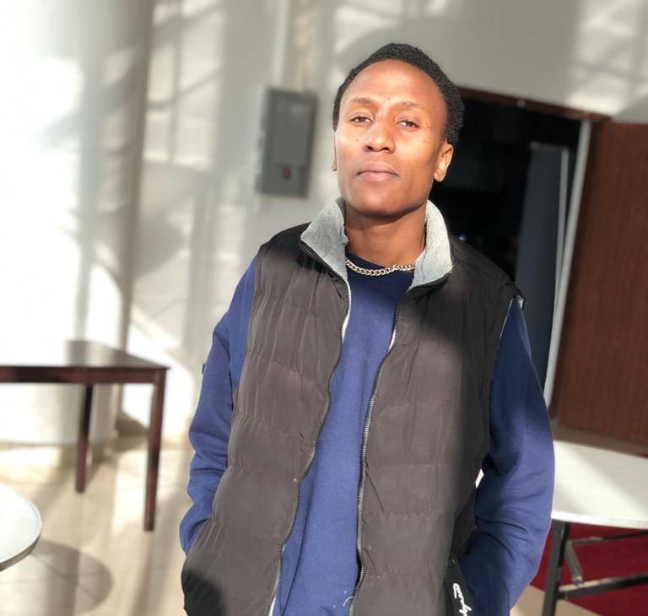
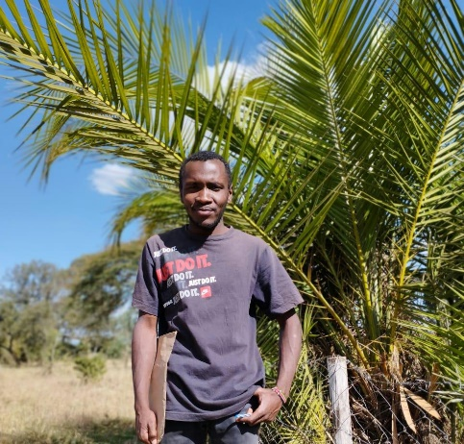

Team
Iain Mosima
Co-Founder and Lead Developer
Kelvin Geita
Founder and Head of Operations
Winston Karanja
Founder and CEO

Slide 13
The Funding Need
We are raising $325,000 pre seed round for 10% equity
Legal
Product development
10%
Marketing
20%
$ 325,000
(Pre-seed)
Team
30%
CAPEX

Slide 14


Contacts
0758605979
0796920420
kevingeita@gmail.com
ngigewinston@gmail.com
iainmosima@gmail.com

